Slide 1
When “Everything” Isn’t Enough:
Ethics, Goals of Care, CPR and Aggressive Treatment
A Medical Contrarian’s View
Greg Phelps MD MPH MA
Tennessee End of Life Partnership
Tuesday, Jan 14th 2014

Slide 2
Just because we CAN do a Thing
Doesn’t mean we should

Slide 3
Contemporary Commentary on the US Health Care System by the AMA
….the current “care system’ provides disjointed specialty services, ignores the challenges of living with disabilities, tolerates routine errors in medications and transitions, disdains individual preferences and provides little support for paid or volunteer care givers. This maladapted service delivery system now generates about half the life time costs for health care services, yet patients and families are left fearful and disoriented, with pain discomfort and distress.
Lynn J., Reliable and Sustainable Comprehensive Care for Frail Elderly People. JAMA Nov 13th 2013 1935-6

Slide 4
Life is a Terminal Illness* but…
There is Never, Ever
“Nothing Else We Can Do…Ever!”
Cure Sometimes, Treat often, Comfort Always
Hippocrates

Slide 5
What I’m Going to Tell You About
In case you were heading for the door!
We (doctors) are not as good as we think
Explore the roll of screening in very elderly and/or terminally ill patients
Explore benefit vs. burden in treatment
Explore Number Needed to Treat
PEG Tubes
Time to Benefit
Discuss the impact of poly-pharmacy
What do patients think about this and the role of “patient centered care.”

Slide 6
Four Cardinal Virtues
(cardo-Ltn-hinge)-
“Requirements to Lead a Virtuous Life”
Prudence - ability to judge between actions with regard to appropriate actions at a given time
Justice - the perpetual and constant will of rendering to each one his right^{[1]}
Temperance or Restraint - practicing self-control, abstention, and moderation; tempering the appetite
Fortitude or Courage - forbearance, endurance, and ability to confront fear, uncertainty and intimidation (from Aristotle, adapted by St. Thomas Aquinas)

Slide 7
BioEthics: Core Principals to live a professionally ethical life
Belmont Report/Georgetown 1979
Three principles:
Autonomy:, the patient has the capacity to act intentionally, with understanding, and without controlling influences that would mitigate against a free and voluntary act. This principle is the basis for the practice of "informed consent" in the physician/patient transaction regarding health care.
Beneficence: health care providers have a duty to be of a benefit to the patient, as well as to take positive steps to prevent and to remove harm from the patient.
Justice. a form of fairness, or as Aristotle once said, "giving to each that which is his due." This implies the fair distribution of goods in society and requires that we look at the role of entitlement. The question of distributive justice also seems to hinge on the fact that some goods and services are in short supply, there is not enough to go around, thus some fair means of allocating scarce resources must be determined.
Later added Human dignity, and non-maleficence.

Slide 8

Physician Assisted Suicide versus effective treatment of pain in the terminally ill
The Doctrine of Double Effect St. Thomas Aquinas d 1274
Twin effects of some actions: the one aimed at, the other “foreseen but not intended”. Four elements
1. The act, considered independently of its harmful effects, is not in itself wrong
2. The agent intends to good and does not intend the harm either as a means or an end, though the agent may foresee the harm
There is no way to achieve the good without causing the harmful effects
The harmful effects are not disproportionately large relative to the good being sought.

Slide 9
Patient Autonomy
In 1891 the U.S. Supreme Court held:
“No right is held more sacred, or is more carefully guarded by the common law, than the right of every individual to the possession and control of his own person.”
However- medical practice remained rigidly patriarchal and authoritarian until 1970’s “The doctor is always right.”

Slide 10
During 1970s and 1980s a Shift Occurred
Families began asking that non-beneficial life-sustaining treatment be discontinued from patients unresponsive to medical interventions .
The patients and/or family’s right to refuse or withdraw medical treatment was recognized by the Supreme Court:
  Karen Ann Quinlan
  Nancy Cruzan
  Terry Schaivo

Slide 11
Today, a New Shift is Occurring
What should happen when the physician believes continuing the patient’s treatment will not benefit or cure the patient and the patient or family disagrees with the physician’s determination about futile or non-beneficial care.

Slide 12
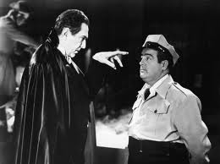
We have Created a Medical Monster!
Why?!
Death, and aging and disease denying culture
It is more cost effective (for doctor and family and hospital NOT to discuss)
Pharmaceutical industry is single biggest spender on lobbying in Washington, followed by insurance companies.
Media creates myths that all problems can be solved with pills or procedures.
*Opensecrets.org

Slide 13
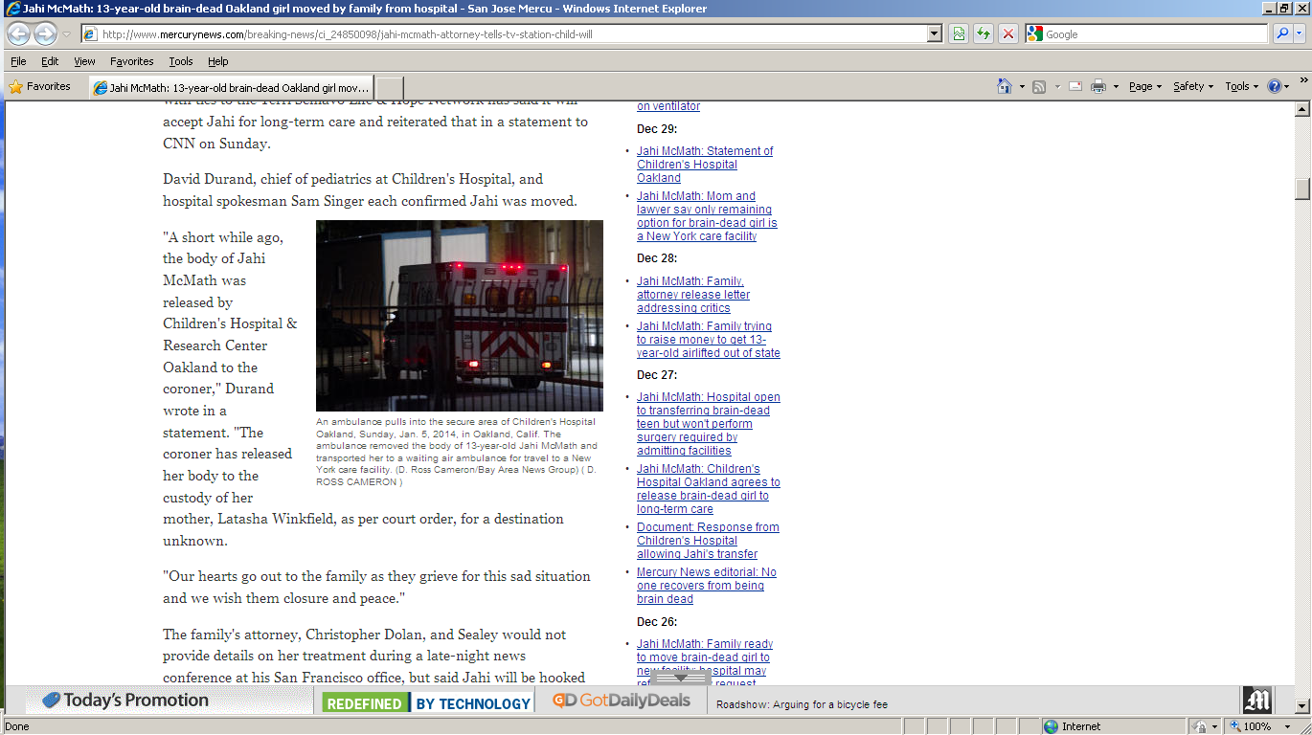
Jahi MCMath-Age 13
Died following complications from tonsillectomy
Multiple doctors have declared her brain-dead, but her family has rejected the diagnosis
a death certificate had been issued for Jahi,
Mr. Dolan (attorney) is not being truthful to the public or his clients," Singer said. "When he says his 'medical team' wants to feed her body so her brain will have the optimum nutrients, he is either being purposely deceptive or ignorant. In either case, he is perpetuating a sad and tragic hoax on the public and the McMath family. Tragically, this young woman is dead, and there is no food, no medical procedures and no amount of time that will bring back the deceased."
San Jose Mercury News Jan 6th

Slide 14
The Problem with Miracles
Some patients (or their families) refuse to engage insisting that “God will cure them, that as a good and faithful person, God will not let them die. (“Magical thinking” combination of denial and barginning)
And if they die does that mean their faith was not strong enough or God doesn’t answer prayers?
Miracles are called such because they are rare to the point they appear to violate laws of biology and physics.
Can always hope for the best while preparing for the worst.
Death comes to us all. At what age is death a just outcome?

Slide 15
Ethical Collision Caveats
Professional autonomy allows that a provider is not obligated to provide care that is clearly non-beneficial
Patient does not have an absolute right to dictate care
Autonomy is more powerful to refuse care than demand care
Social (or Distributive) Justice is a growing area of concern

Slide 16
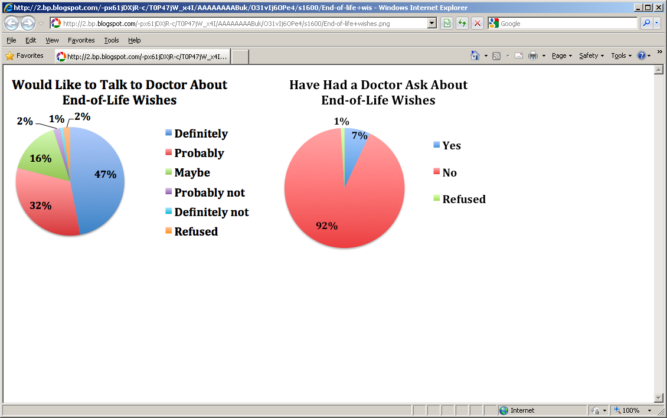
California Healthcare Foundation Survey 2012
70% -90% of patient’s say they would prefer to die at home (about 30% do) 66% say
they would prefer to die a natural peaceful death. Only 7% desire
all invasive therapeutic options deployed.
AMA News reports 80% of patients surveyed feel it is important to have advance directives but only 24% have done them. (2012, 02/27th)

Slide 17

Communication at the End of Life

Slide 18
End of Life Discussions
Subjects terminal cancer patient
4.4 month life expectancy
123 of 332 (37%) patients with terminal illness had end of life discussions
“Have you and your doctor discussed any particular wishes you have about the care you would receive if you were dying?”
These patients elected less aggressive care with fewer ICU admits 4.1% vs 12.4%, fewer ventilation episodes 1.6 vs 11%,
More aggressive care was associated with poorer quality of life for the patient and higher risk of major depressive disorder for bereaved care givers. (PTSD)
Study showed that patients did not have increased depression or loss of hope.
AA Wright, B Zhang A.Ray et al, Associations Between
End of Life Discussions Patient Mental Health, Medical Care Near Death
And Caregiver Bereavement Adjustment. JAMA 1665-1673. Oct 8, 2008

Slide 19
CAPC Survey of Attitudes
For Patients with Serious Illness
800 patient’s surveyed
Released June 28th 2011
Available at CAPC.org
Biggest concerns: Cost, Control, Communication, Choice, Cure?
  Physicians not providing all treatment options- 55%
  Doctors not sharing information with each other-55%
  Doctors not choosing best option for seriously ill- 54%
  Patient and family leave physician office not knowing what they are supposed to do when they get home-51%
  Patient lacks control over treatment options- 51%
  Doctor doesn’t spend enough time talking and listening with patient and family 50%

Slide 20
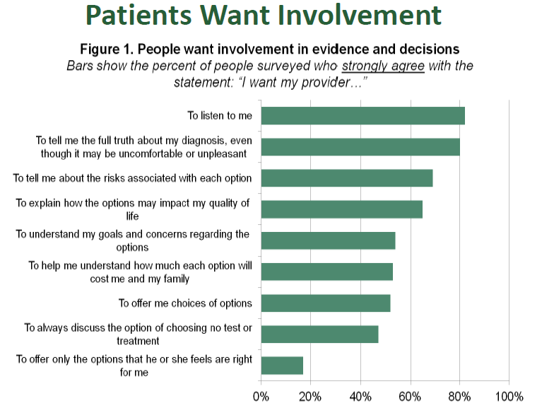
Institute of Medicine Report
Sept 2013

Slide 21
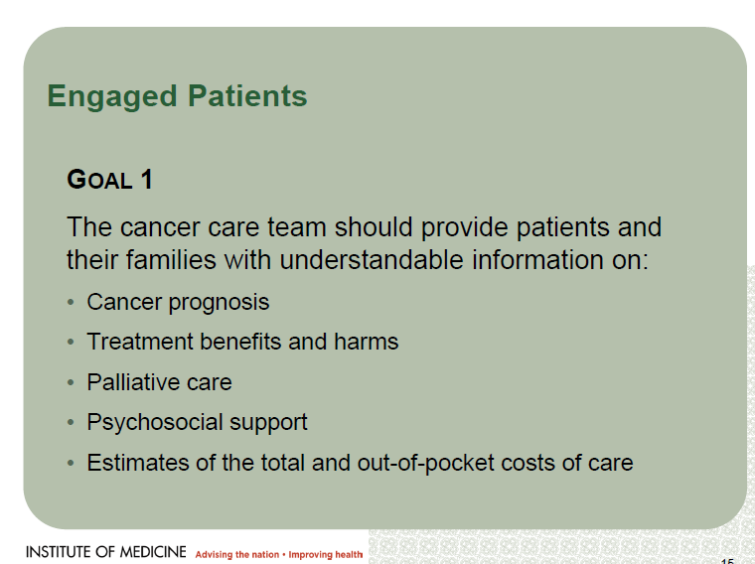

Slide 22
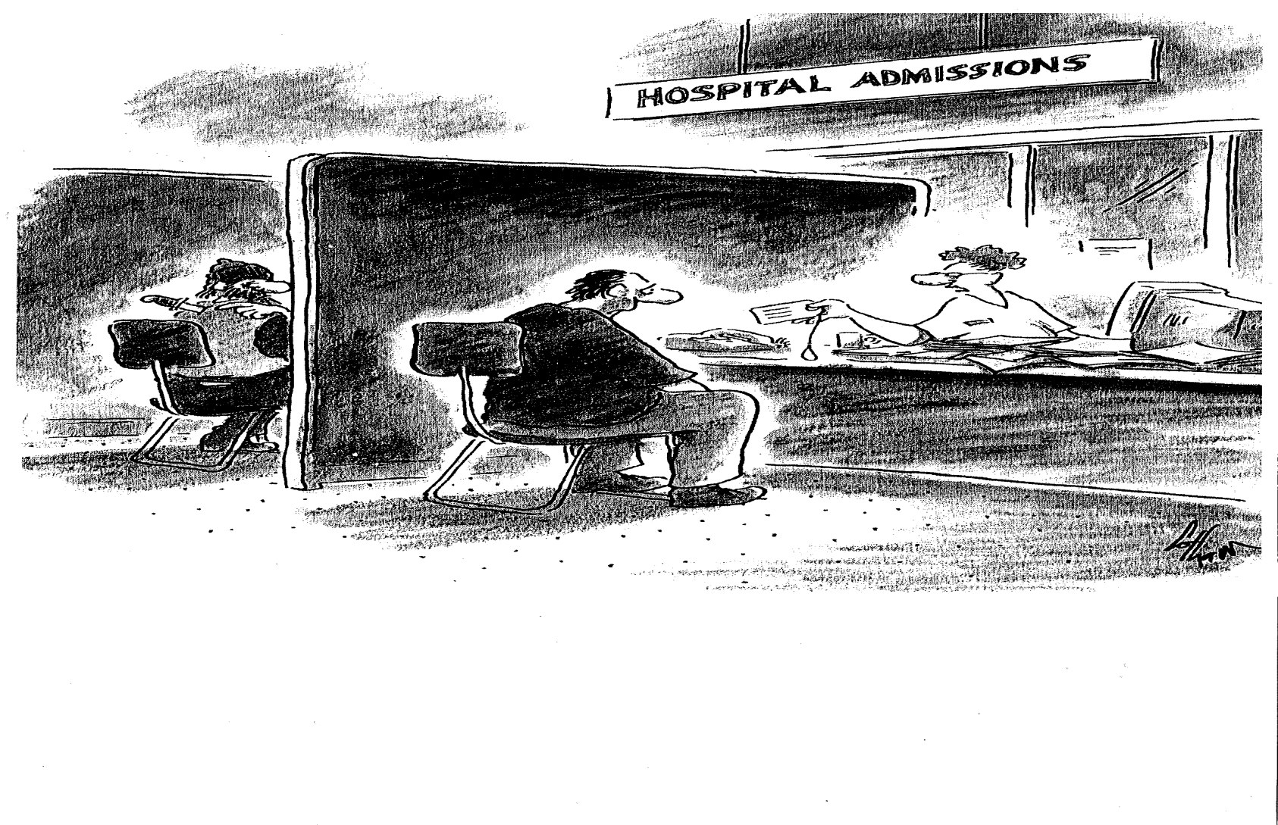
Hospitals Can be Dangerous to the Elderly (and others)
“Here---Fill out this tag and attach it to your toe.”

Slide 23
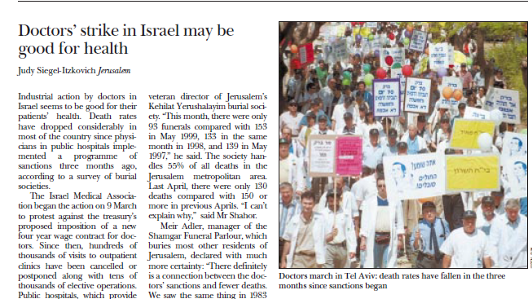
Don’t Tell the AMA!
Doctor’s in Israel Strike 1999
British Medical Journal 10 June 2000 p 1561
Hundreds of Thousands of clinic visits and tens of thousands of elective
Surgeries cancelled- The result,---Deaths fell from 153 to 93 that month.
“We saw the same thing in 1984.” The one hospital with a ‘no strike’ clause
had the exact same number of deaths year over year 87

Slide 24
Hospital Associated Disability
JAMA Oct 26th, 2011 Covinsky KE, Pierluissi E., Johnston CB
Loss of ADLs during acute hospitalization.
Occurs in 1/3 hospitalized patients > 70
> 50% of patients > 85 leave hospital with new disability
1/3 of hospitalized elderly have delirium (more commonly hypoactive delirium)
41% of elderly who developed HAD DIED! In under one year, another 29% still disabled at one year

Slide 25
Steps to Avoid HAD
Avoid the “One Point Restraints” when possible: Urinary catheters, IVs, O2 catheters, NG tubes
Better recognition of functional status
Exercise/ walk patients if at all able.
Ensure patient is eating properly
Avoid sedative hypnotics and anti-histamines
Recognize and palliate pain and symptoms

Slide 26
Geriatric Frailty
“ A Physiologic syndrome characterized by decreased reserve and diminished resistance to stressors resulting from cumulative decline across multiple physiologic systems causing vulnerability to adverse outcomes “ American Geriatric Society
Three of Five:
Secondary Criteria:
Loss of Muscle strength
Unintended weight loss
Increased sleep or low activity level
Poor endurance easy fatigue
Unsteady gait or slowed performance
Decreased cognition
Decreased balance
Deficient social support
Poor motor processing Poor health (self reported)
Frailty in general associated with 300-500 increased risk of mortality

Slide 27
Mechanisms of Geriatric Frailty
Sarcopenia: after age 40 8-12% muscle loss per decade most replaced with fat. After 75 process accelerates
Neuro-endocrine dysfunction: low testosterone, estrogen, insulin growth factor, DHEA, cortisol, growth hormone.
Chronic Low Grade inflammation: adipose tissues secrete pro-inflammatory cytokines like IL-6 etc.

Slide 28
Curative/Functional/Palliative
Curative | Functional | Palliative
Goal: Cure Disease | Goal: Maintain/improve function | Goal: Comfort care
Object of Treatment is disease | Object of treatment is disease while not impacting function of patient | Object of treatment is Patient and Family
Primary value is measurable data- labs X-rays test (tends to devalue subjective immeasurable data) | Primary value is assessment of function to determine appropriate level of treatment | Primary Value is patient experience of suffering and symptoms
Patient’s body differentiated from mind and often divided into treatable body parts by specialty | Patient’s function as both body and mind must be protected | Patient is viewed as complex being with emotional, physical social and spiritual components
Therapy is indicated to cure disease or slow progression. | Therapy is scaled to what patient can tolerate without likelihood of additional functional loss (Avoid “one point restraints) | Therapy is indicated for relief of symptoms or suffering and congruent with patients Values and beliefs
Death is the Ultimate Failure | Helping patient hold off loss of function until the very end is a success. | Enabling Patient to live fully and comfortably until he or she dies is a success

Slide 29
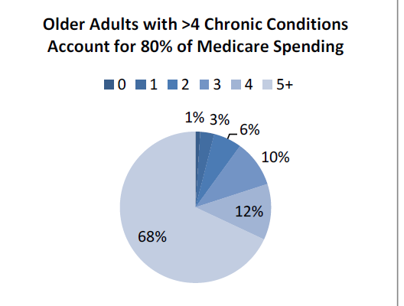
Those who live past age 65
Now average3 years of self-care
Disability at the end of life.
From J Lynn see later ref.
American Geriatric Society

Slide 30
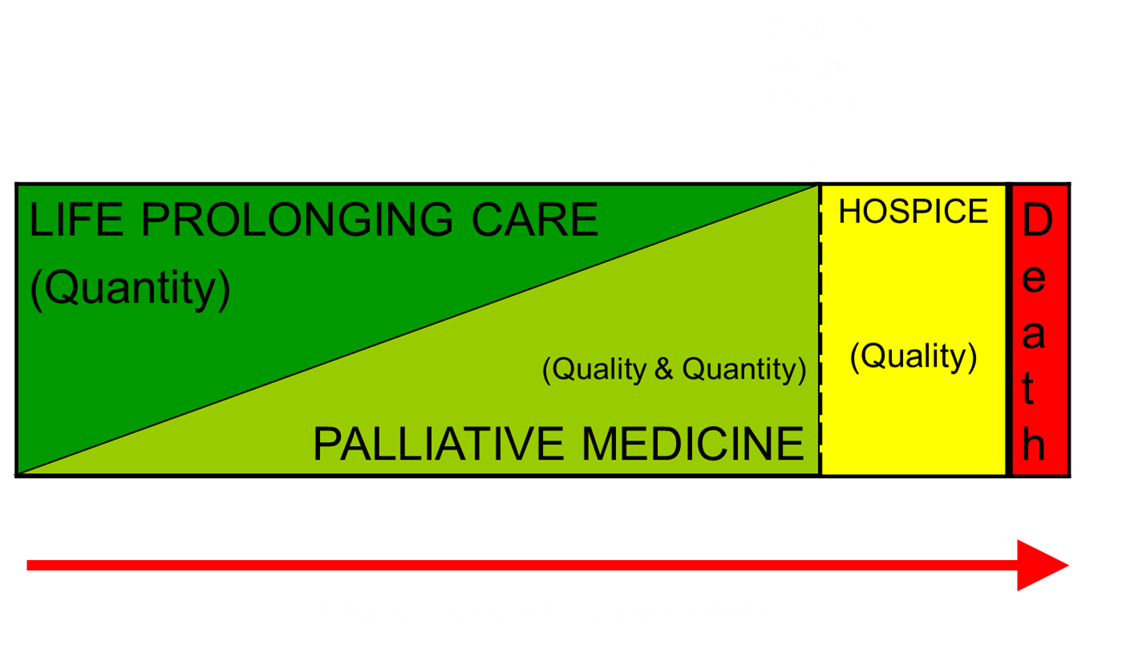
Everyone is entitled to SOME
Palliative Care

Slide 31
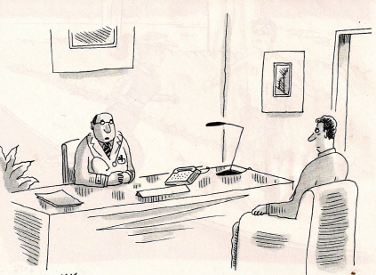
Where Does ‘Do Everything!’
Apply Clinically
I’m Sending you to someone less squeamish

Slide 32
CPR and AND/DNAR/DNR
“The low rate of success of CPR may be an example of how a medical myth is perpetuated by the media because it is more appealing than the truth”-Robert Schmerling
Success rate for CPR on TV was 65-100% the show to die on is Rescue 911*
Diem, SJ., LantosJ.D., Tulsky, JA. Cardiopulmonary Rususitation on Television NEJM 33:1578-82

Slide 33
Actual CPR
Success* in the hospital, rates 13-20% average about 15%
Out of hospitals rates 10% or less.
Success in CPR is less age dependent than illness dependent.
Overall 15%
Frail elderly %
Advanced Chronic illness metastatic Ca, multi organ failure in bed more that ½ waking hours
0-3%
A Review of ACLS Medications at theNNT.org found “No Benefit” to ACLS medications although defib helpful.
Success often defined as surviving to discharge

Slide 34
CPR injuries
CPR injuries- rib fractures >30%
Brain injury- of the 18-20% who survived in one study* 58% were still alive one year later however, 52% had moderate to severe neurologic injury and 60% went to a nursing home.
Additional injuries: pneumothorax perforation of organs and or lacerations to internal organs.

Slide 35

The Nudge:
Libertarian Paternalism
Choice architecture
Design a system where all options remain but the best choice is most obvious.
Asking do you want to ‘allow natural death’ as opposed to Do you want us to restart the hear yields a 20% decrease in requests for CPR.
Families don’t want to be asked to allow their loved one to die- be proactive and recommend a code status
Education changes desire to be coded. Study of 371 seniors over 6o41% wanted CPR. After education on survival odds, that dropped to 22%. -Compassionandsupport.org

Slide 36
Medical Screening
Survey of physicians-
About 45% of physicians said they would screen a 50 year old with unresectable lung cancer
About 37% of physicians would screen a 65 year old with unresectable lung cancer
25% of physicians would screen an 80 year old with un-resectable lung cancer
reported in Geripal.og
Actual Screening in cancer patients
Mammography: 9% among patients with advanced cancer vs. 22% among patients without cancer
PAP smears: 6% vs. 13%
PSA testing: 15% vs. 27%
Colonoscopy: 2% vs. 5%
Cancer Screening Among Patients With Advanced Cancer
Camelia S. Sima, MD, MS; Katherine S. Panageas, DrPH; Deborah Schrag, MD, MPH JAMA. 2010;304(14):1584-1591. doi:10.1001/jama.2010.1449
Alzheimer’s
In another study in the American Journal of Public Health it was found that 18% of women with
Severe Alzheimer’s Disease (life expectancy 3.3 years had had a mammogram in the last two years.

Slide 37
Screening to Treating
Survey in JAMA Internal Medicine found half of patients would NOT have a screening test if the test resulted in more than one person being over treated to avoid one cancer death. Breast Cancer Screenings: What We Still Don’t Know- H Gilbert WelchNY Times 12/29/2013
Fact of one thousand 50 year old women screened for a decade, between 490-670 women will have at least one false alarm, of these thousand, between 0-3 cancer deaths will be averted versus 3-14 over-diagnosed and treated needlessly
Quantifying the Benefits and Harms of Screening Mammography
H. Gilbert Welch, MD, MPH¹; Honor J. Passow, PhD¹
JAMA Intern Med. Published online December 30, 2013.
PSA Screening: Black rating- harmful, no lives saved, 20% harmed by biopsy

Slide 38
Why Continue Screening ?
American Cancer Society does not recommend cancer screening in people with a life expectancy under 5 years.
Doctors receive grades based on screening scores.
Doctor’s receive bonuses based on quality scores.
Doctors don’t want to have the hard conversation as to life expectancy under five years.

Slide 39
The Beer’s List-(No Happy Hour Here!)
1991 Group of geriatricians under Mark Beers MD formulated a list of medications to be given to the elderly only with significant additional fore thought due to increased risk in the elderly. (Not a ban)
1999 CMS incorporated Beers list into nursing home regulations (Haldol is not on Beer’s list)
Opioids on Beer’s list include: meperidine, (Demerol) Pentazocine (Talwin) propoxaphene (Darvon- recently removed from US market)
NSAIDS on Beer’s list
For a full listing of the Beer’s list search by this name

Slide 40
Pill Burden
Many common illnesses treated by the PCP are illnesses of the 21st century and are reflective of poor diet, smoking and lack of exercise.
People no longer die of TB, malaria, starvation
Now they die of heart disease, stoke, cancer and Alzheimer’s etc.
The current medical model is built on a concept of acute illness where the prevailing epidemiology is chronic illness and risk factor treatment
These include-
Diabetes- Type 2
Hyperlipidemia
Hypertension
Osteoporosis
Many of the Medicines don’t work as well as we wish and have complications, side effects and interactions.

Slide 41
Number Needed to Treat-NNT
Osteoporosis/Alendronate-Primary prevention vertebral fracture NNT=50, Secondary NNT 16*
Cholesterol/statins: NNT primary prevention of non-fatal MI= 60 (Taken x 5 years) 98% saw no benefit, 0% were helped by being saved from death, 1.6% were helped by preventing a heart attack, 0.4% were helped by preventing a stroke. 2% were harmed by developing diabetes, 10% were harmed by muscle damage**
Stroke/warfarin: NNT 25 to prevent stroke**
*Cochrane Reviews 2008
**Statins warfarin, theNNT.org

Slide 42
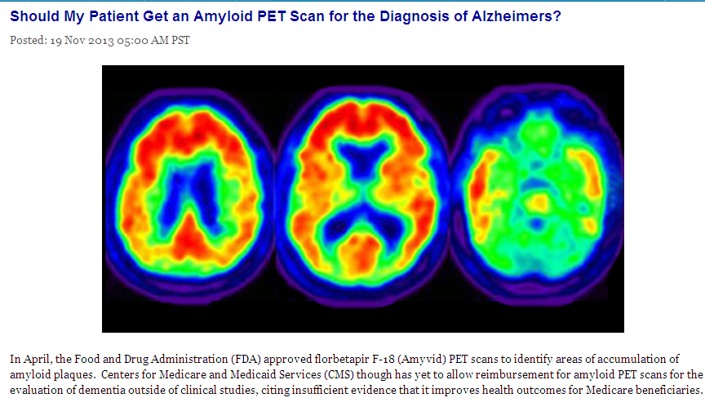
Alzheimer’s Disease
Eli Lilly with Alzheimer Drugs in the pipeline and the Alzheimer’s Association
whom Eli Lilly gave $1.6 Million, both objected to this finding. (NY Times- Alzheimer’s Anxiety 11/16/2013)

Slide 43
Alzheimer’s Meds
In general Alzheimer’s medication has relatively low benefit for a decidedly small percent of patients. Estimate are that the number needed to treat is between 3-7 patients for modest benefit of perhaps 1-2 points on a mini-mental status exam of 30 points. Most statisticians recommend 10% improvement) Even then patient will resume losing ground after an initial, minimal improvement but the rate of decline may not be quite as fast. The Anti-cholinesterase are only indicated for mild to moderate Alzheimer’s, not severe Alzheimer’s.
Finally most of the studies on these mediations have been for six months and any benefit is felt to last as most 18 month to at the very outside, three years. Many patients however are desperate to try these medications and many experts will OK a trial for three months then retest. If no improvement the medications should be discontinued as side effects can be substantial, often causing discontinuation in 20-25% of patients

Slide 44
What Meds Don’t Do
“The medications used to treat Alzheimer’s disease are not particularly effective. When compared with placebo most people will not experience meaningful benefit. And it is the rare person who has significant delay in worsening of symptoms. Consumer’s Guide: Best Buy Drugs- Evaluating Prescription Drugs Used to Treat Alzheimer’s Disease (May 2012)
Combining Aricept and Namenda although common is no more effective than either by itself. Howard R, McShane R, Lindesay J et al. Donepezil and Memantine for Moderate-to-Severe Alzheimer’s Disease NEJM March 8th, 2012 893-903

Slide 45
What Else Alzheimer’s Meds Don’t Do
Aricept/donepezil do not help with agitation more than placebo. Howard, RJ., Juszcak E, Ballard CG. Et al, Donepezil for the Treatment of Agitation in Alzheimer’s Disease. NEJM Oct 4 2007 1382-1392
Namenda/Memantine : Memantine does show a statistically significant slowing of decline in Severe Alzheimer’s patients but the change is minimal. On the Mini-mental status exam over 28 weeks the decline was 0.6/30 for the treated group versus 0.9 for the untreated group. The CIBIC- Plus score
Declined from a baseline of 4 (worst of 7) to 4.4 in the treated group and 4.7 in the untreated group.
Reisberg, B., Doody, R., Albrecht, S., Memantine in Moderate to Severe Alzheimer’s Disease.
NEJM April 2003. 1333- 1341
It is Always Money- When Aricept lost it’s patent, Pfizer came out with Aricept 23mg because it was difficult to replicate generically. Unfortunately as the BMJ noted it was no more efficacious and had considerably more side effects than the original Aricept 10 mg.

Slide 46
Blood Pressure
In general hypertension takes years to have and effect on kidneys heart and stroke. In general the higher the blood pressure the more damage. African American’s seem more vulnerable. Reductions below 140/90 not beneficial
Treatment of blood pressure without previous cardiovascular events participants showed no difference between treated and untreated individuals in heart attack, stroke, and death. About 9% of patients treated with drugs discontinued treatment due to adverse effects Cochrane reviews
Lower BP w DM? four of five studies funded by drug makers showed tiny reduction in stroke but a substantial increase in serious adverse events. (Cochrane reviews)

Slide 47
Feeding Tubes and the Dementia “Death Spiral
Scenario: Repeat admission for severely demented nursing home patient with pneumonia.
Patient resists feeding, chokes a little, nurses suggest swallowing study to hospitalist.
Swallowing study demonstrates aspiration
GI is consulted for feeding/Peg tube to “improve nutrition, and reduce aspiration.”
tube placed patient returns to nursing home.
Pulls tube out, restrained replaced gets pneumonia
AND REPEAT!, Repeat, Repeat
Family conference
Death
Fast Facts- 084

Slide 48
Feeding Tubes and the Dementia
51% of severe AD patients will try to refuse food.
Inability to maintain nutrition orally in the face of a chronic life limiting illness is usually a marker of the dying process.
Risk factors INDEPENDENT of patient for getting a feeding tube include: speech therapist on full time staff, larger facility, more Medicaid, fewer assistants
Nursing Homes receive higher reimbur$ement for tube fed patients.
JAMA Evidence-Care at the Close of Life. McPhee, Winkler Rabow et al editors, Chapter 12 2011

Slide 49
Feeding Tubes DO NOT
Prevent aspiration,
Improve function or quality of life,
Increase comfort
Improve weight gain
Improve wound healing
Substantially increase life expectancy

Slide 50
So What Do We Do With Failing Patients?
4 things that need to be done to assure better care for frail older persons
1. Honest discussion: We should stop deluding the public with the message that late life frailty is a preventable problem. Of course good health habits should be encouraged. But most who do all the right things will still have a period of disability when they reach advanced age. Let's stop telling the public that exercising and eating blueberries will avoid this problem. Let's instead talk about how to maintain good quality of life in elders with late life disability.
2.Better advance care planning based on each elders goals that targets care and services based on each elders individual needs. (Maybe we can call these "life panels")
3.Care delivery in the elder's home. For disabled elders, just making it to a doctors office can be an insurmountable hurdle.
4. A care system that embraces long term supportive services and medical care as equal partners. "food, transportation, and direct personal services are often more important than diabetes management or transportation"
Lynn j. Reliable and Sustainable Comprehensive Care for Frail Elderly People
JAMA Nov 13th, 2013 1935-36

Slide 51
Changes in Hospice
Medicare Patients:2000-2009
Number of patients dying at home increased from 24.6% to 32.6%
Number of terminally ill patients using hospice increased from 21.6% to 42.3 %
However!!! 1/3 of patients dying in hospice had been in ICU in previous 30 days
Percent of patients dying in under 3 days increased to 28.4%

Slide 52
Lacrosse Wisconsin
The best place in America to end your life.
Gunderson Lutheran 25 year effort to promote advance care planning
90% of patients have advanced care plans (more than twice the national average)
Patients spend 13 days in the hospital in final two years of life versus national average of >30
US ranks 9th in ‘first world’ in end of life care.

Slide 53
So What Happens to the Elderly
(Survey 4158 Seniors)
Non-Hospice Patients
Hospice patients
Elderly patients avg. age 83
75% visit ER in final 6 months (40% more than once)
>50% visit ER final month
Of those in ER, 75% admitted
39% admitted to ICU
68% admitted died in hospital
Hospice Patients
Less than 10% seen in ER
Vast majority die at home
Smith AK, McCarthy E, Weber E et al; Half Of Older Americans Seen In Emergency Department In Last Month Of Life; Most Admitted To Hospital, And Many Die There. Health Affairs. June 2012 31:61277-1285

Slide 54
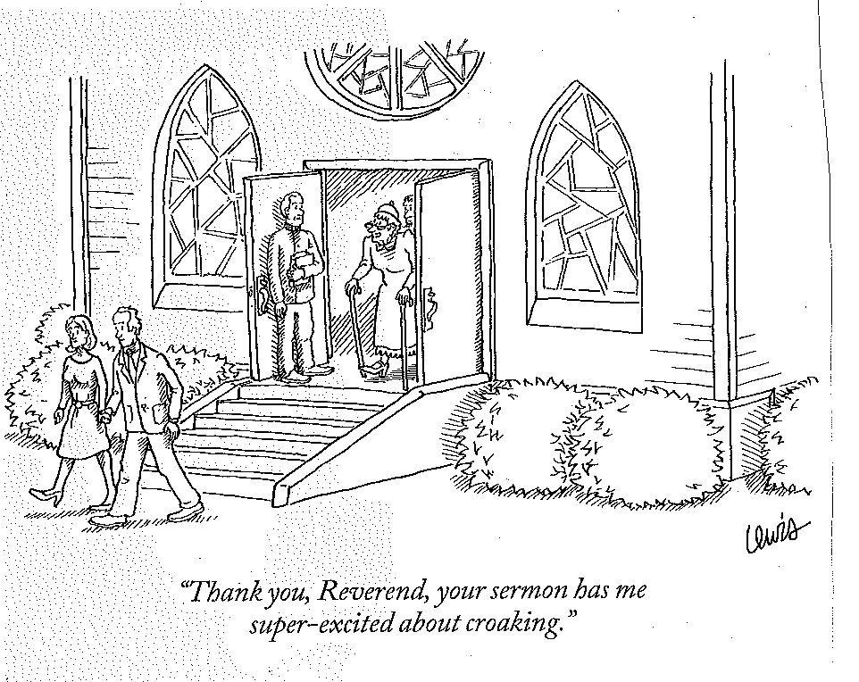
The End-Thank You

Slide 55
Resources
Blogs: Pallimed Geripal, Medicalfutilty (great for keeping up)
Cochrane Reviews Cochrane.org
TheNNT.org
Fast Facts www. eperc.mcw.edu/EPERC/FastFactsand concepts
American Academy of Hospice and Palliative Medicine- AAHPM.org
Hospice and Palliative Nurses Association www.hpna.org
National Hospice and Palliative Care Organization -NHPCO.org
Center for the Advancement of Palliative Care- CAPC.org
Palliativedoctors.org (AAHPM’s website for patients)
Hospice and Palliative Care Formulary USA (Palliativedrugs.com)
Greg Phelps MD gregory.phelps@lhcgroup.com

Slide 56
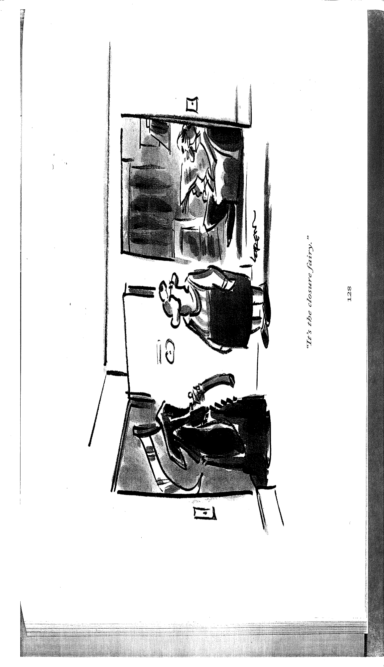
The Lost Art-of Prediction
It is the closure fairy

Slide 57
Mechanisms of Geriatric Frailty
Sarcopenia: after age 40 8-12% muscle loss per decade most replaced with fat. After 75 process accelerates
Neuro-endocrine dysfunction: low testosterone, estrogen, insulin growth factor, DHEA, cortisol, growth hormone.
Chronic Low Grade inflammation: adipose tissues secrete pro-inflammatory cytokines like IL-6 etc.

